Slide 1
Things to be seen or done on First log in by the User

Slide 2
Learning Objectives
How to ‘Update your profile to continue’ on first log in
How to ‘View Facility Information’
How to crosscheck Form types linked to your user type
How to change your profile details using ‘My Profile’
How to ‘Update Facility Details’
How to ‘Change Password’
How to ‘Logout’
How to ‘Reset Password’ in case the you forget your password

Slide 3
After typing the relevant link (https://ihip.nhp.gov.in/idsp/#!/login) in the URL, you will come to the “Sign In” page

Slide 4
Write Username and Password in the relevant fields and enter the CAPTCHA; then click on “Sign In” button to log in

Slide 5
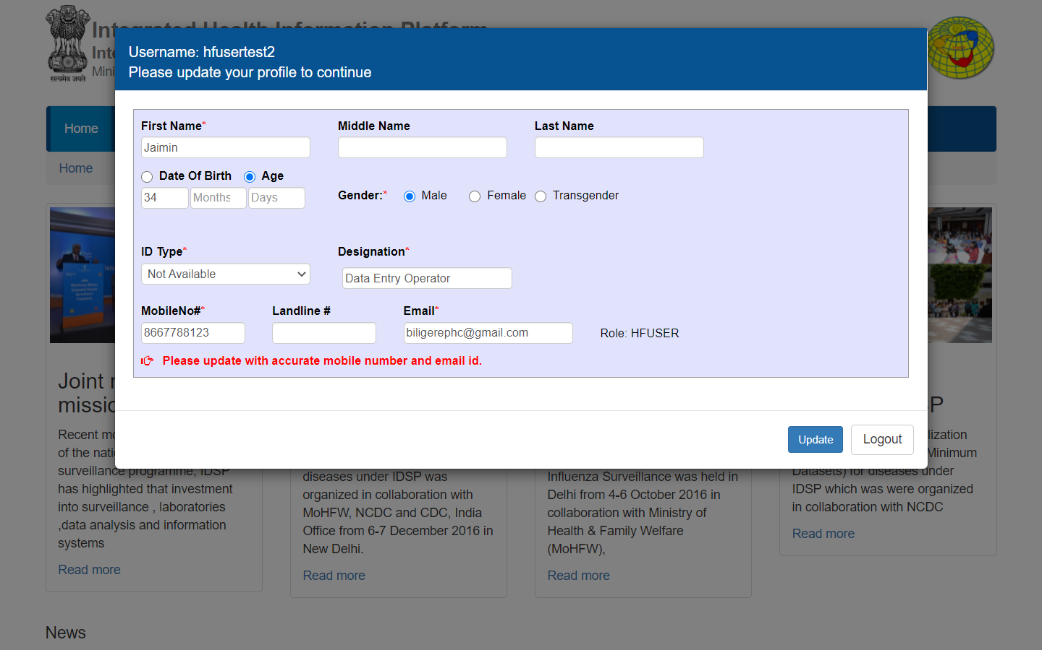
When you log in for the first time with your username, you will be prompted to ‘Please update your profile to continue’; Update all the data fields esp. the mandatory fields (marked with *) and then click on “Update”; otherwise your will have to ‘Logout’

Slide 6
The home page that you will see after log in
Click on
User Name

Slide 7
Click on
“View Facility Information”

Slide 8
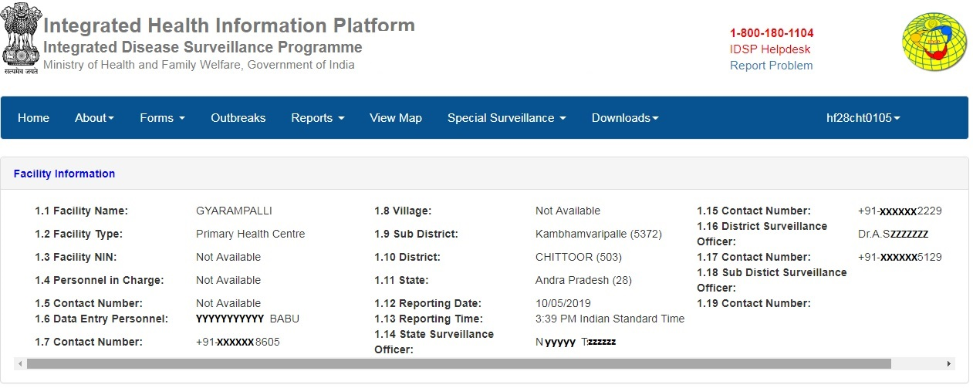
The user can see and cross check whether the Facility Information including the details of the personnel incharge and officers is correct or not; if the data field is showing “Not Available” then this information needs to be updated from the relevant menus as it will be discussed in subsequent slides

Slide 9
Then Click on
“Forms”

Slide 10
Again Click on
User Name
This is done to see whether the web portal is showing all those forms that the particular user account must have; here the user is of a PHC, so must have P form and Event Alert form and the same is being displayed here; it means that the web portal is showing the right types of Forms; this needs to be cross checked by each user on first log in

Slide 11
Click on
“My Profile”

Slide 12
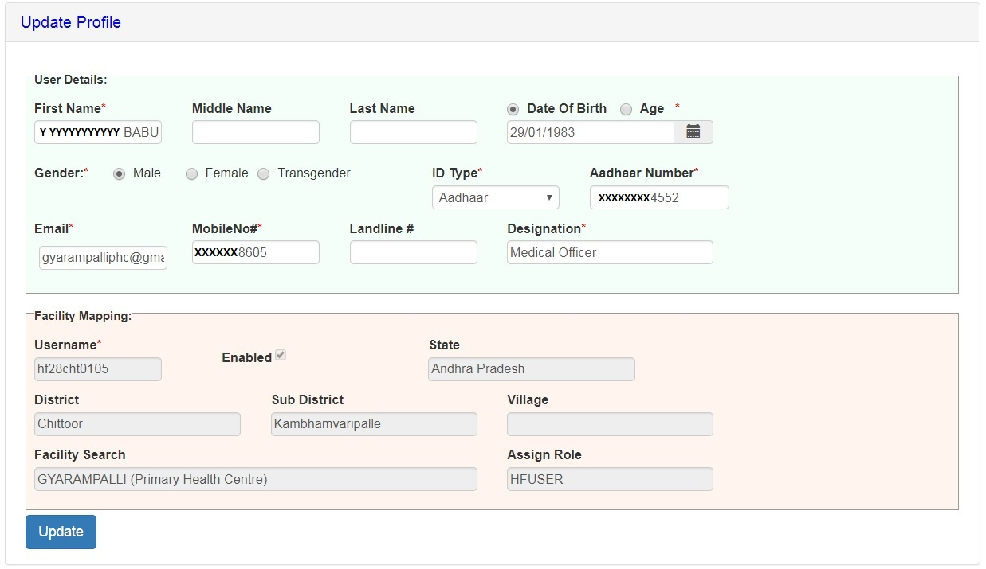
This page will have already been updated if the user has filled in the his or her profile details on ‘Please update your profile to continue’ page; the user can update his or her details if it changes in future using ‘My Profile’

Slide 13
User can’t update anything in the fields under “Facility Mapping”; if find anything wrong in “Facility Mapping” then user can Report the problem to District Surveillance Unit and DSU staff can edit this thing using ‘Manage User Accounts’ [it will be discussed in ‘Administration’ menu] using districtadmin user ID

Slide 14
Now click on
“Update Facility Details”

Slide 15
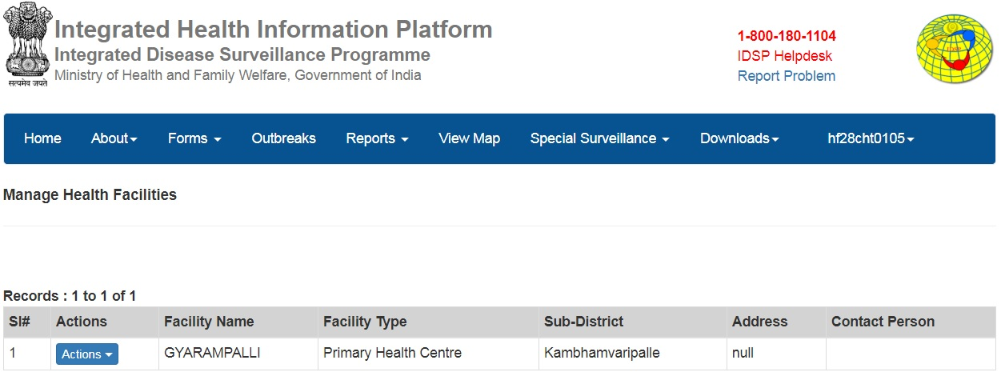
Click on
“Actions”

Slide 16
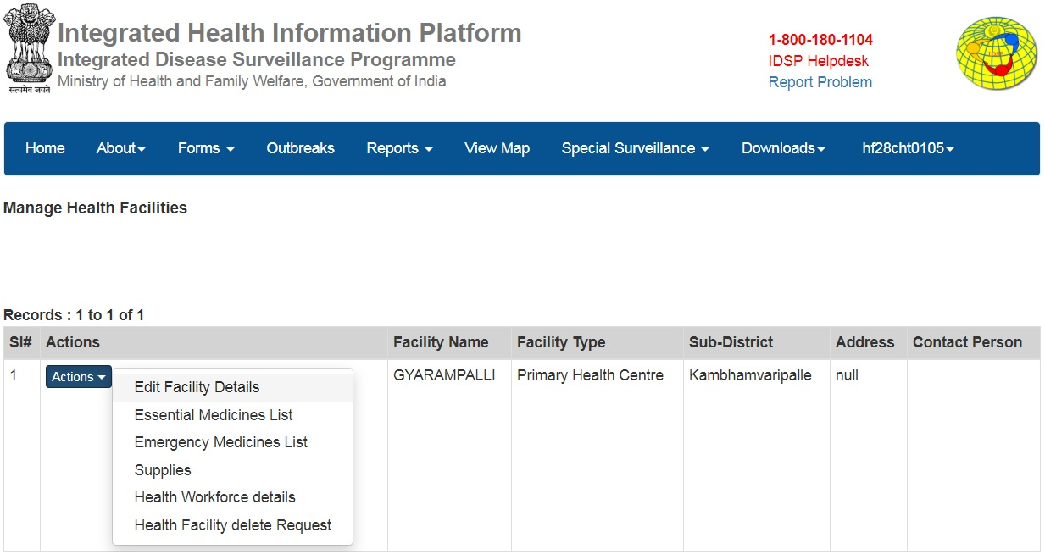
Then Click on
“Edit Facility Details”

Slide 17
Fill in / Update data fields related to address of the facility and also the data fields related to Officer Incharge of the facility, especially the mandatory fields (marked with *) then click on “Update”;
This might have already been done by DSU staff; facility user can crosscheck and edit / update as required;
Name and Mobile number of Officer In-charge is the most important as he/she will receive Alert messages on the given mobile number only

Slide 18
You can’t update these facility details as these fields are locked; if you find anything wrong here, then kindly report to District Surveillance Unit for corrections

Slide 19
You can’t change/update/select the “Sub Centers covered” under Primary Health Center user account as this data field is locked; if you find anything wrong here then kindly report to District Surveillance Unit as they can change/update/select the “Sub Centers covered” under Primary Health Center through the “Administration” menu

Slide 20
Similarly, one can’t change/update/select the “Villages covered” under Health Sub Center user account as this data field is locked; if you find anything wrong here then kindly report to District Surveillance Unit as they can change/update/select the “Villages covered” under Health Sub Center through the “Administration” menu

Slide 21
Now Click on
“Validate Location in The Map” to correct the geo-location of the Health Facility

Slide 22
…you can simply type the name of landmark near to the health facility and this data field will offer you to select from the options given from Google search
You can select the Marker and change/drag it’s position to more accurate geo-location of the Health facility or…
This is a Sub District border
You can click on “+” to zoom in and click “-” to zoom out
Let’s Click “-” to zoom out

Slide 23
This is a District border
This is a State border
Click on “-” again to zoom out further

Slide 24
This is a State border
Click on “Update” if you have changed the position

Slide 25
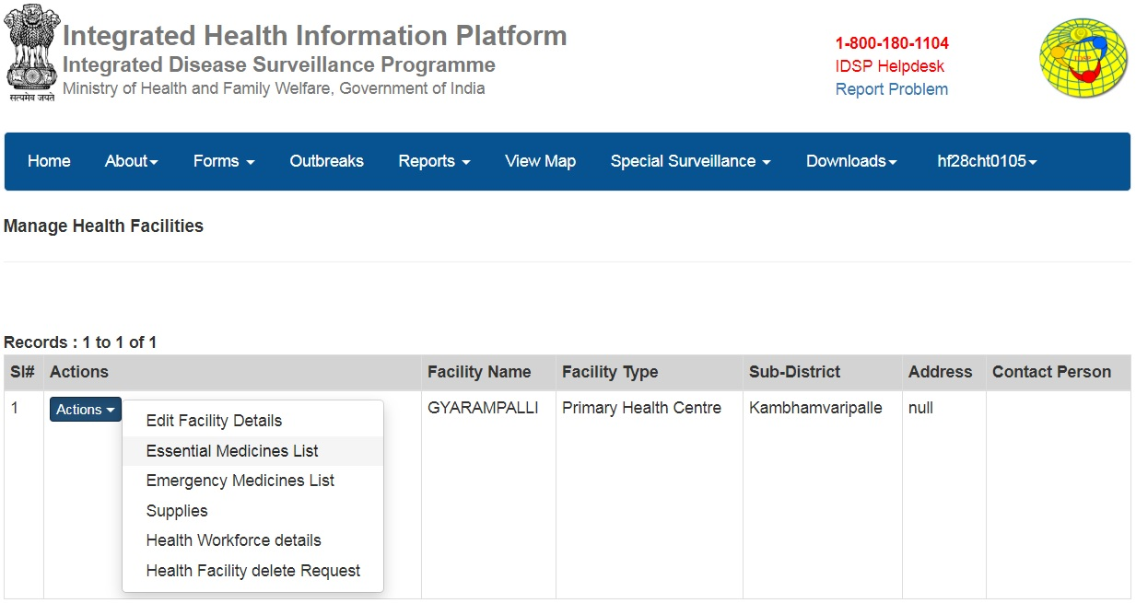
Click on
“Essential Medicines List”

Slide 26
On first log in, you might not see any medicine in the list so you need to select the type of Medicines group/s from “Essential Medicines List” followed by selecting the name/s of the Medicines from “Item Description”; then select the “Unit” of the medicines and then current “Quantity” and then click on “Save” to save; in this way you can add each Medicinal item at the health facility with their quantity

Slide 27
This is how the list would look like, once all the “Essential Medicines” are in this list, the user has to just edit the Quantity on regular basis using “Edit” button for each Medicine

Slide 28
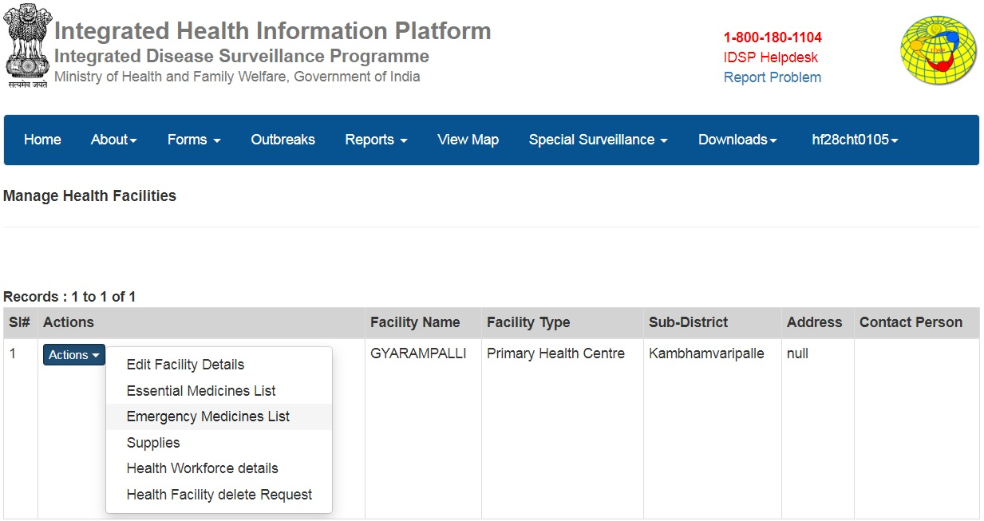
Click on
“Emergency Medicines List”

Slide 29
On first log in, you might not see any medicine in the list so you need to select the type of Medicines group/s from “Medical Supply Type” followed by selecting the name/s of the Medicines from “Item Description”; then select the “Unit” of the medicines and then current “Quantity” and then click on “Save” to save; in this way you can add each Medicinal item at the health facility with their quantity

Slide 30
This is how the list would look like, once all the “Emergency Medicines” are in this list, the user has to just edit the Quantity on regular basis using “Edit” button for each Medicine

Slide 31
Click on
“Supplies”

Slide 32
Update Equipment details: “Required” vs “Available”; this is usually a one time activity but may require update whenever there is a change in equipment numbers
you may also add any comment under “Remarks”
and then click on “Submit” to update

Slide 33
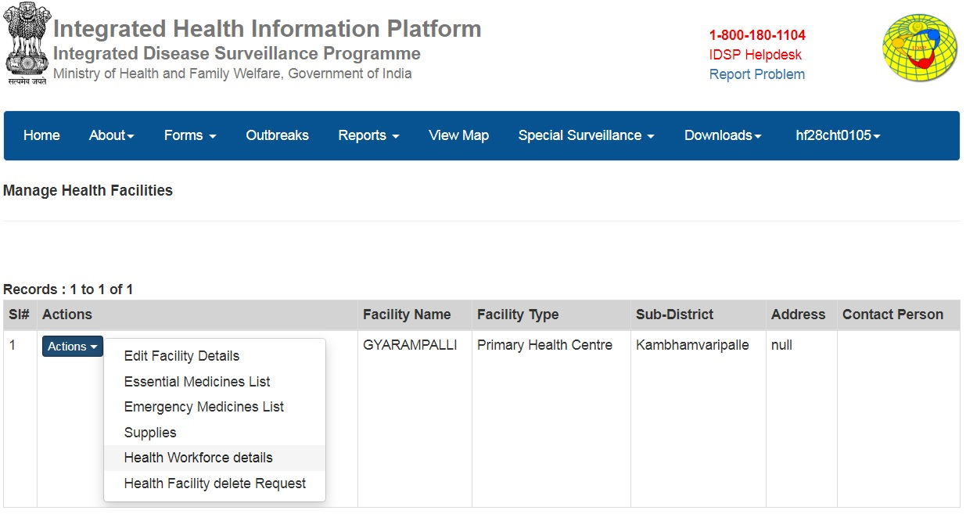
Click on
“Health Workforce details”

Slide 34
Update Health Workforce details: “Required” vs “Working”; this is usually a one time activity but may require update whenever there is a change in health staff numbers
you may also add any comment under “Remarks”
and then click on “Submit” to update

Slide 35
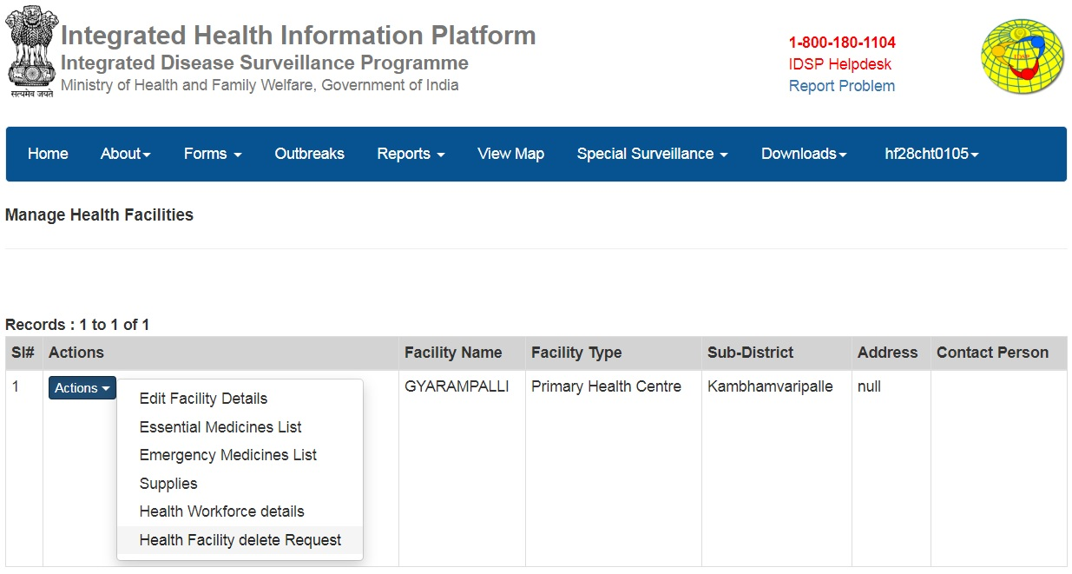
Click here only if you think that the same health facility has been duplicated or this health facility does not exist at all to generate a request for deletion; usually you would not require to use this as District Surveillance Unit would have already crosschecked and cleaned the Master Health Facility data

Slide 36
Click on
“Change Password”

Slide 37
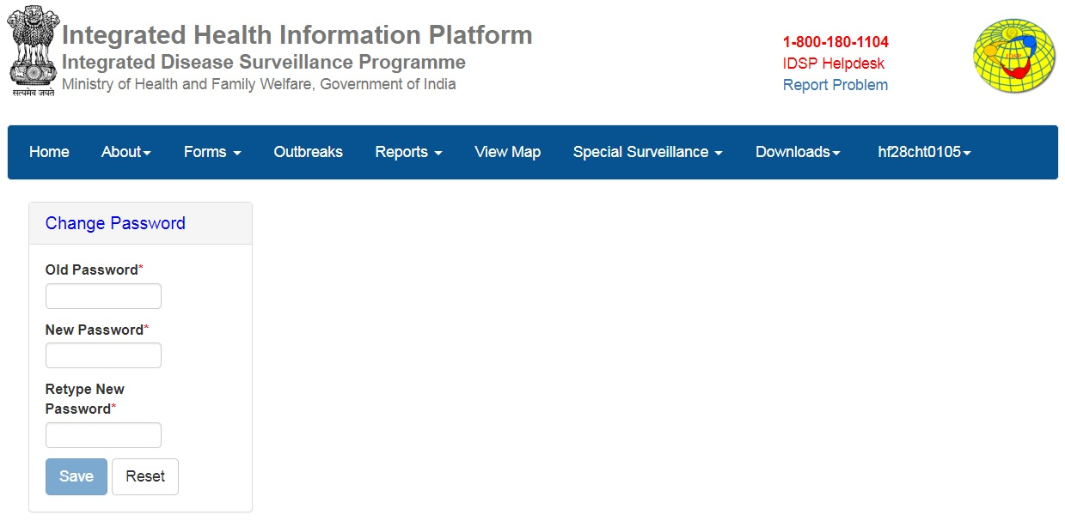
Type the “Old Password” and then type the New password that you want to keep; retype the new password and then click on save to update the New Password (remember the new password)

Slide 38
Click on
“Log out” to log out from IHIP account

Slide 39
If you forget your password then you can change your password using ‘Reset Password’

Slide 40
Type your username and click on ‘Submit’

Slide 41
You will receive an OTP in your mobile number that you saved under ‘My Profile’ section; type that OTP here and then click on ‘Verify’; if you don’t receive OTP then wait for few seconds; if you still don’t receive then click on ‘Resend OTP’ and try to get OTP again

Slide 42
Type the ‘New Password’ that your want to keep and ‘Confirm’ the same and then click on ‘Submit’

Slide 43
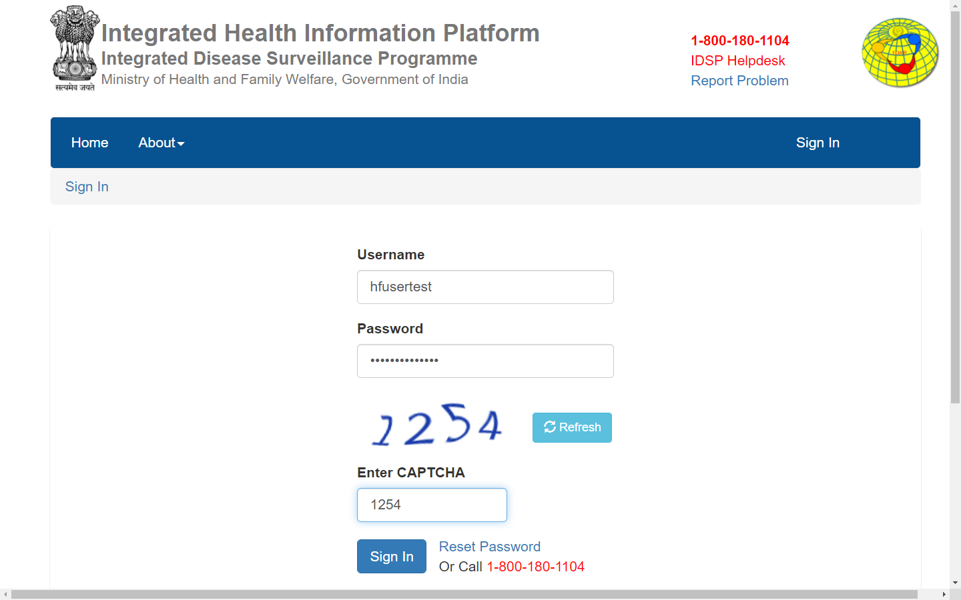
Type the ‘New Password’ [that you just reset] on Sign In page to log in your user account

Slide 44
If you forget your Username then please contact your facility in charge &/or DSU staff
If you are not getting the OTP after several attempts or mobile number in ‘My Profile’ page is not yours then inform DSU staff to ‘Reset Password’ on behalf of you or ‘Edit User Details’ (esp. your mobile number) using “Manage User Accounts” function under ‘Administration’ menu

Slide 45
Thank You

