Slide 1
Implementation of Integrated Health Information Platform (IHIP)

Slide 2
Requirements
The States are requested to ensure the availability of followings items to initiate reporting of data related to IDSP using IHIP
working computer systems and regular internet connectivity at each health facility/reporting unit
adequate manpower trained for IHIP at every level for monitoring including identified data entry personnel at health facility for data entry
Proper mechanism to capture & record the requisite data for entering into IHIP including MANDATORY fields

Slide 3
The process of data reporting on IHIP under IDSP (2 phases/steps)
Step I: Verification of master data of health facilities (including examining of User IDs & Passwords, Creation of User Profiles, Health facility directory etc.) – This is a one-time initial activity to setup basic information
Step II - Reporting of disease surveillance data (including event alerts & outbreak) - Continuous activity to be carried out in real time manner

Slide 4
Step I: Verification of master data of health facilities
A) Examination of User IDs & Password
B) Creation of User Profiles
C) Creation of Health facility directory
This step is largely the responsibility of District Surveillance Unit under the overall Guidance & Supervision of State Surveillance Unit; some of things can be updated by User him/herself as well

Slide 5
A) Examination of User IDs & Password
Cross check whether User ID & Password for EACH health facility has been received or not [https://ihip.nhp.gov.in/#!/]
Check the functionality of EACH User ID & Password
After log in, also please confirm that appropriate form (S, P & L) & relevant user access has been provided (we will discuss about Relevant User access in coming slides)

Slide 6
Write Username and Password in the relevant fields and enter the CAPTCHA; then click on “Sign In” button to log in

Slide 7
This is done to see whether the web portal is showing all those forms that the a particular user account must have; here the user is a PHC, so must have P form and Event Alert form and the same is being displayed here; it means the web portal is showing the right types of Forms; this needs to be cross checked for each user ID

Slide 8
A) Examination of User IDs & Password (Cont…)
Instructions to users:
The same steps to be repeated by the each user once they receive the user ID and password
Check functionality of user ID and password
Confirm whether appropriate form opens
Don’t change password at least for 6 months until IDSP module of IHIP get stabilized
User IDs & Passwords are to be used for factual data entry only (not to be used for training or test purpose); for training purpose one can use Learning / Training platform –http://ihiptraining.in/idsp/#!/login)
There is a separate presentation on “Things to be seen or done on first log in by the User”

Slide 9
B) Creation of User Profiles
Why?
to identify the user/personnel associated with the User IDs
to get details of password, in case it is forgotten
Please fill in relevant details in respect to the user profile such as Name, Age, Gender, Contact details etc. of users associated with each health facility, district & State

Slide 10
User profile details that need to be registered against each type of user
B) Creation of User Profiles (Cont…)
Account | Sr. No | Type of User | User profile details
Health facility | 1 | Sub centre | ANM or whoever is doing S form entry
 | 2 | Primary Health Center (P Form) | Medical Officer I/c (In-charge) or whoever is doing P form entry
 | 3 | Primary Health Center (L Form) | Medical Officer I/c (In-charge) or whoever is doing L form entry or Lab technician
 | 4 | Other health facilities (P Form) e.g. CHC, SDH, DH, MCH etc. | In-charge of health facility or official designated for P form data collection (Physician) or whoever is doing P form entry
 | 5 | Other health facilities (L Form) e.g. CHC, SDH, DH, MCH etc. | In-charge of health facility or official designated for L form data collection (Microbiologist/ Lab technician) or whoever is doing L form entry
Administrative office | 6 | Block (Sub-district)* | Block Health officer
 | 7 | District | District Surveillance Officer
 | 8 | State | State Surveillance Officer
*to be issued yet

Slide 11
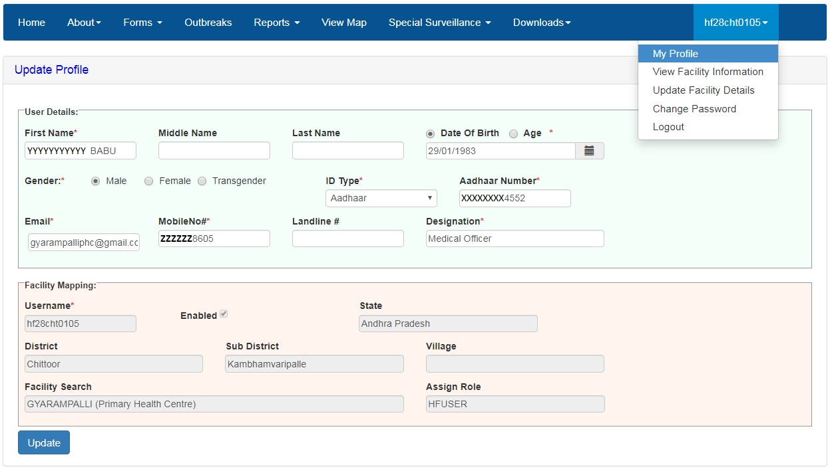
Fill in / Update all the data fields under “User Details” esp. the mandatory fields (marked with *) and then click on “Update”; this can be done by the DSU staff when they log in for the first time to cross check the functionality of the user ID; if not done at that time then it can be done by the User himself/herself when they log in for the first time

Slide 12
User or DSU staff can’t update anything in the fields under “Facility Mapping”; if find anything wrong in “Facility Mapping” then user or DSU staff can Report the problem through Helpdesk by clicking on “Report Problem”

Slide 13
C) Creation of Health facility directory
cross-check the total number of health facilities & their different types as available in the IHIP vs that actually existing in the State in terms of numbers & types
examine & cross-check the mapping
PHC to SCs
SC to Villages
This part is covered in the presentation named as “Manage Health Facilities part 2” and this is largely a responsibility of DSU staff

Slide 14
Select different filters to select particular list of Health Facilities and then cross check each to see whether all the IDSP reporting Units are covered or not or if there is duplication of health facilities or list contains health facilities which are not IDSP RU

Slide 15
The Health facility (P/L form) user can’t change/update/select the “Sub Centers covered” under Primary Health Center as this data field is locked in their account; District Surveillance Unit user can change/update/select the “Sub Centers covered” under Primary Health Center through the “Administration → Manage Health Facilities → Actions → Edit Facility Details” and they need to do the same before distributing user IDs and Passwords to Health Facilities

Slide 16
Similarly S form user can’t change/update/select the “Villages covered” under Health Sub Center as this data field is locked in their account; District Surveillance Unit user can change/update/select the “Villages covered” under Health Sub Center through the “Administration → Manage Health Facilities → Actions → Edit Facility Details” menu and they need to do the same before distributing user IDs and Passwords to S form users

Slide 17
C) Creation of Health facility directory (Cont…)
Health facility details including name, mobile, landline & email ID of officer in charge of health facility need to be updated from “edit/update health facility” option
Each health facility can update Essential medicine list, emergency medicine list, equipment supplies, health workforce details and can also request new user IDs for health facility

Slide 18
Officer In-charge details that need to be updated under “Edit/Update Facility Details”
C) Creation of Health facility directory (Cont…)
Account | Sr. No | Health Facility (type of user) | Officer In-charge details
Health facility | 1 | Sub centre (S form user) | Medical Officer In-charge of the PHC to which the Health Sub Center belongs
 | 2 | Primary Health Center (P Form user) | Medical Officer In-charge of the PHC
 | 3 | Primary Health Center (L Form user) | Medical Officer In-charge of the PHC
 | 4 | Other health facilities (P Form user) e.g. CHC, SDH, DH, MCH etc. | In-charge of health facility or official designated as Nodal person for IDSP
 | 5 | Other health facilities (L Form user) e.g. CHC, SDH, DH, MCH etc. | In-charge of health facility / lab or official designated as Nodal person for IDSP
Administrative office | 6 | Block (Sub-district)* | Block Health officer
 | 7 | District (DSO user and District admin user) | District Surveillance Officer
 | 8 | State (SSO user and State admin user) | State Surveillance Officer
*to be issued yet

Slide 19
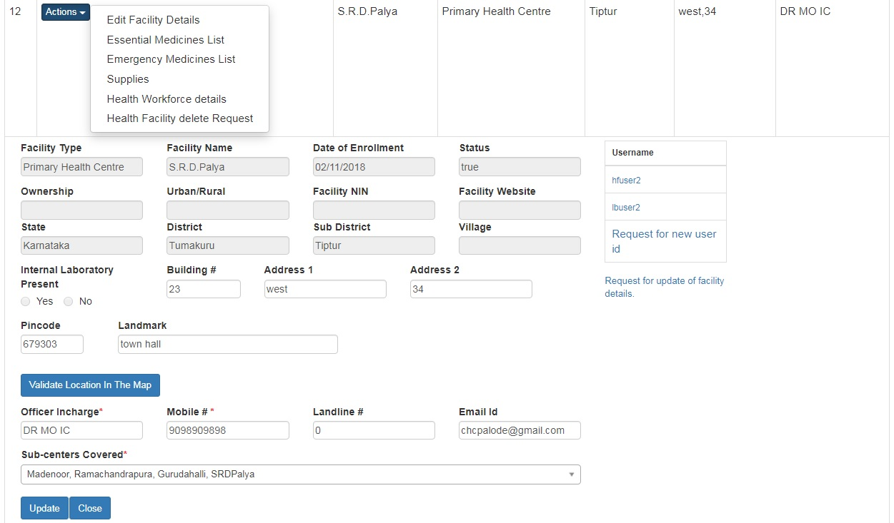
Fill in / Update data fields related to address of the facility and also the data fields related to Officer Incharge of the facility, especially the mandatory fields (marked with *) then click on “Update”;
This needs to be done preferably by DSU staff when they log in through individual user ID for crosschecking the functionality of the user ID or they can do the same by DSU user ID while crosschecking the Facility Details through “Administration → Manage Health Facilities → Actions → Edit Facility Details” or it can be done by the facility user him/herself when they log in for the first time though “username → Update Facility Details”; Name and Mobile number of Officer Incharge is the most important as he/she will receive Health Condition Alert on the given mobile number only

Slide 21
C) Creation of Health facility directory (Cont…)
State and District user need to check different types & numbers of health facilities available in IHIP through health facility dashboard from Administration menu
State and District user can add new health facility / add new RRT / update health facility details / delete health facility through Administration Module [this is covered in the presentation named “Manage Health Facilities part 1”]

Slide 22
Step II - Reporting of disease surveillance data
S form (Suspected Cases form) from Sub Centres
Mobile App – S form (Data Entry) [Separate presentation]
S form (Suspected Cases form)
S form (Death Form)
Event Alert form
Desktop version – S form (Data Entry) [Separate presentation]
S form (Suspected Cases form)
Reporting Deaths
Event Alert form

Slide 23
Step II - Reporting of disease surveillance data (cont…)
P form (Presumptive Case Form) from health facility – PHC and higher [Separate presentation]
P form data entry
Add patient record
Add death record
Record aggregate data
Event alert form

Slide 24
Step II - Reporting of disease surveillance data (cont…)
L form (Laboratory Case Form) from laboratories linked with the health facilities doing P form entry) [Separate presentation]
L form Data entry

Slide 25
For any problems, please call IDSP Help Desk at 1-800-180-1104.
Please also report problems using https://ihip.nhp.gov.in/helpdesk/
This instruction is for every user i.e. S/P/L form user, DSU user, SSU user; there is a separate presentation on “how to use Help Desk”

Slide 26
Thank You

