Slide 1
Downloads menu

Slide 2
Learning Objectives
To learn different submenu (as following) under “Downloads” menu
Download App
ToT Documents
Blank forms
User Guides
Video Tutorials

Slide 3
After typing the relevant link (https://ihip.nhp.gov.in/idsp/#!/login) in the URL, you will come to the “Sign In” page

Slide 4
Write Username and Password in the relevant fields and enter the CAPTCHA; then click on “Sign In” button to log in

Slide 5
The home page that you will see after log in
Click on
“Downloads”

Slide 6
Different Submenus under
“Downloads” menu;
let’s see them one by one

Slide 7
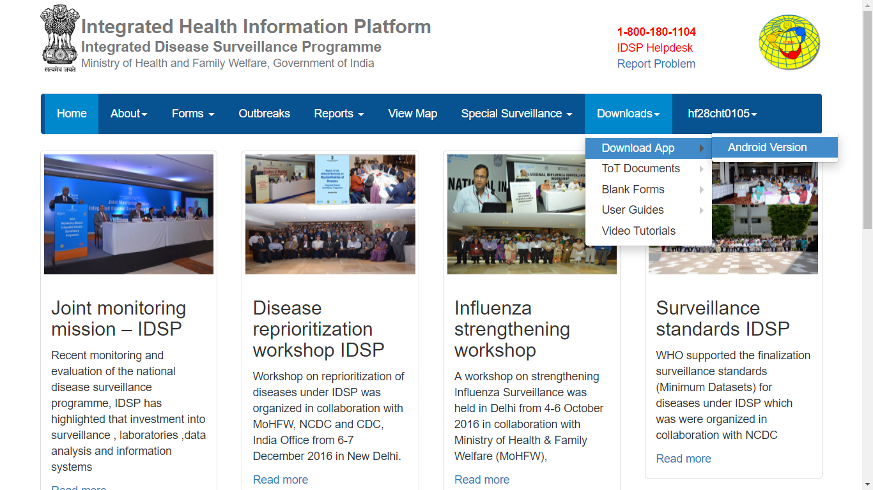
Let’s first click on “Download App” and then click on “Android Version” to download the “.apk” file to install the IHIP android app on Mobile or Tablets having Android operating system

Slide 8
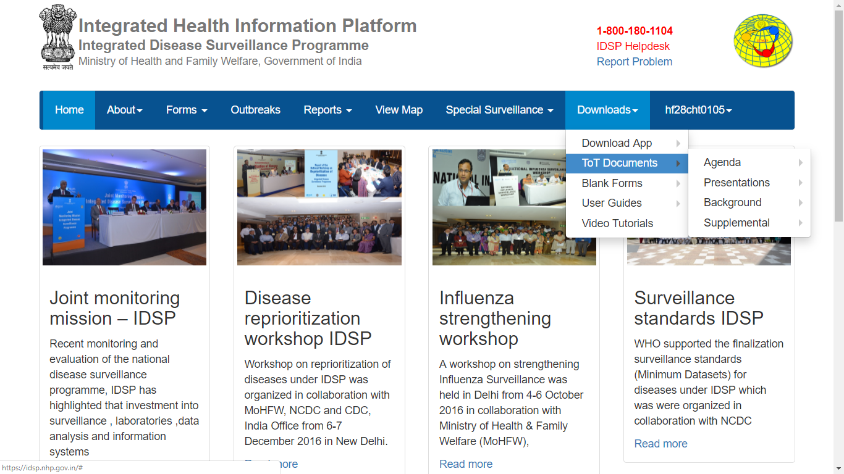
Then click on “ToT Documents” to download various materials related to Training of Trainers; currently it does not have anything uploaded but in near future, various training material will be uploaded under this submenu

Slide 9
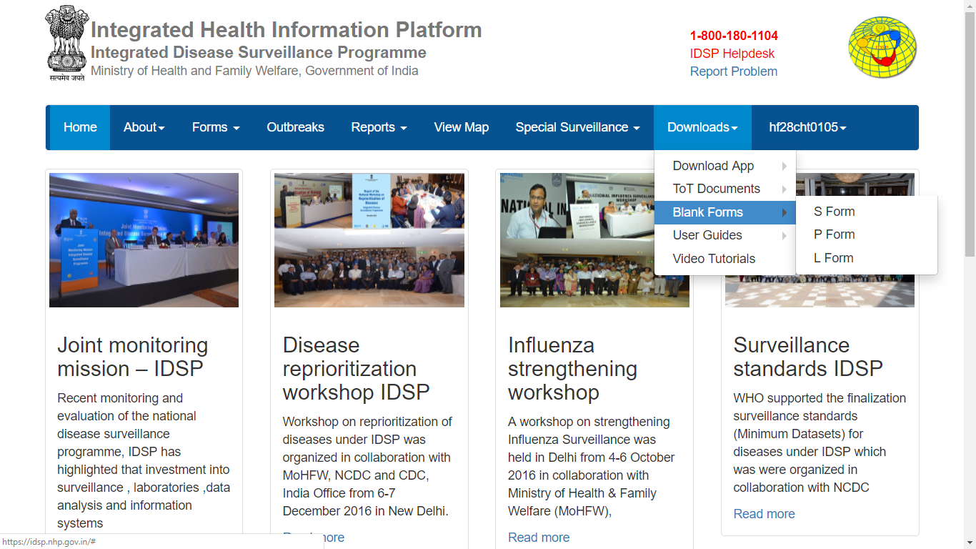
Then click on “Blank Forms” to download S form or P form or L form; usually you do not require to download them except for blank S form which might be required in case the health workers have not been given tablet / mobile to punch Syndromic cases data using IHIP app and have to enter the aggregate data using desktop web portal of IHIP

Slide 10
Then click on “User Guides” submenu to download User Guides or User Manuals prepared with regard to different Users or Specific Menu or Specific Functions; they have been uploaded recently that’s why you can see “New” label in front of each user guide

Slide 11
Now Click on
“Video Tutorials”

Slide 12
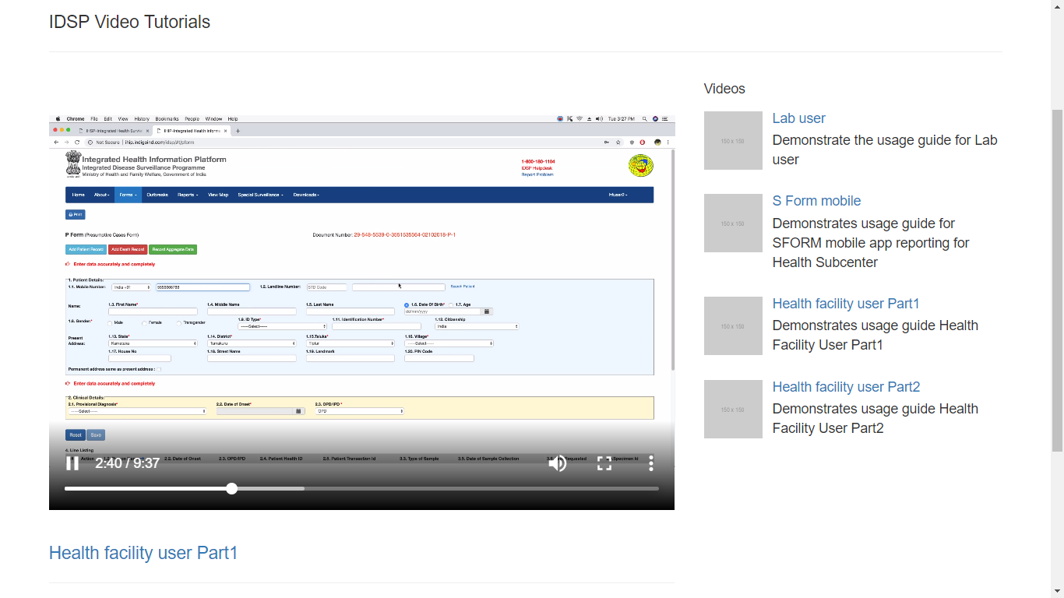
One can click on specific video link to know about that. The links are prepared for different users and accordingly the user can select the link for which he or she needs to know how to utilize IHIP web portal for data entry or seeing / doing other menus / functions such as “Reports”, “View Map”, “Administration” etc.

Slide 13
Thank You

