Slide 1
Performance Dashboard
IHIP – IDSP

Slide 2
Introduction
Performance dashboard is available under ‘Reports’ ‘Dashboard’
It shows the performance ranking of Districts/States based on scoring criteria
The scoring criteria used is based on the:
Reporting Performance
Urban area mapping (wards to sub centers)
Outbreak response

Slide 3
Weightage For Performance ranking

Slide 4
Calculation basis
Scoring is done on daily basis
For selected period the mean score(average) for that period is shown
For S / P / L Forms – % RUs reported on the day inclusive of nil reporting (adapted to a maximum score for 20 points for each form type)
Cases reporting - % RUs (S+P+L) reported at least one case on the day (nil reporting excluded) – maximum score 10 points
Urban mapping - % Urban Wards mapped with sub center – maximum score 10 points
Outbreak response – has two elements:
Event alert response time – % Event Alerts (out of reported) responded within 48 hours (2 days) during last three months
Outbreak completion - % Outbreak completed (out of reported) during last three months

Slide 5
Performance Dashboard - Scores
On top various filters are given to select State / District / Date range
Below filters Total Score followed by score for individual components is shown

Slide 6
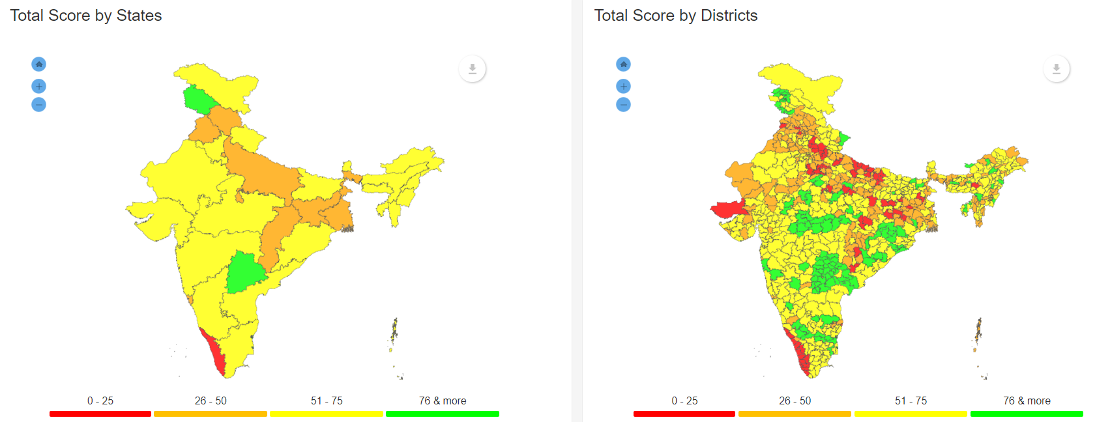
Dashboard - Maps
Map of States / Districts showing ‘Total Score’ by ranges
On selecting a particular ‘State’ from filter on the top – ‘Districts’ for that particular state are shown
Home / Zoom in / Zoom out buttons are given for better visual experience
Data / Image can be exported by clicking on given button

Slide 7
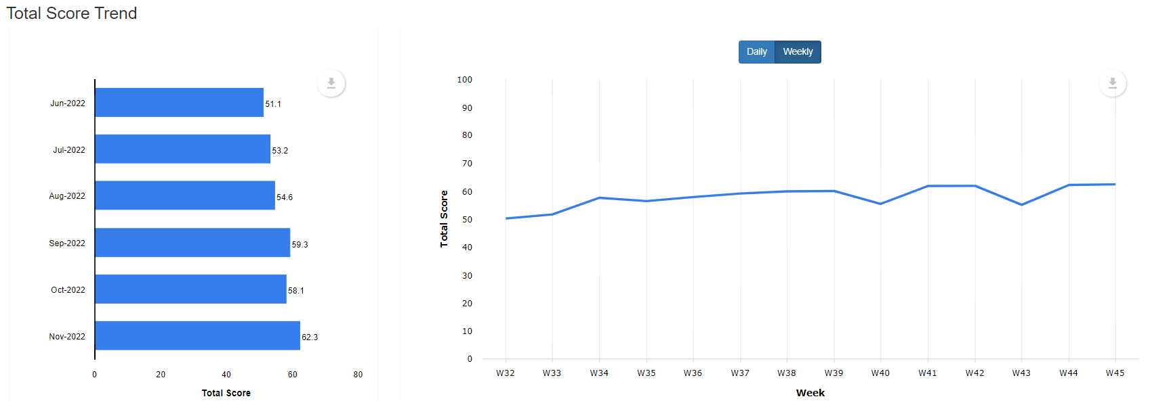
Dashboard – Score trend
On the left – Monthly mean score for the last six months is shown
On the right – The day / Week wise score trend for the selected period is shown
Data / Images can be exported by clicking on the given button

Slide 8
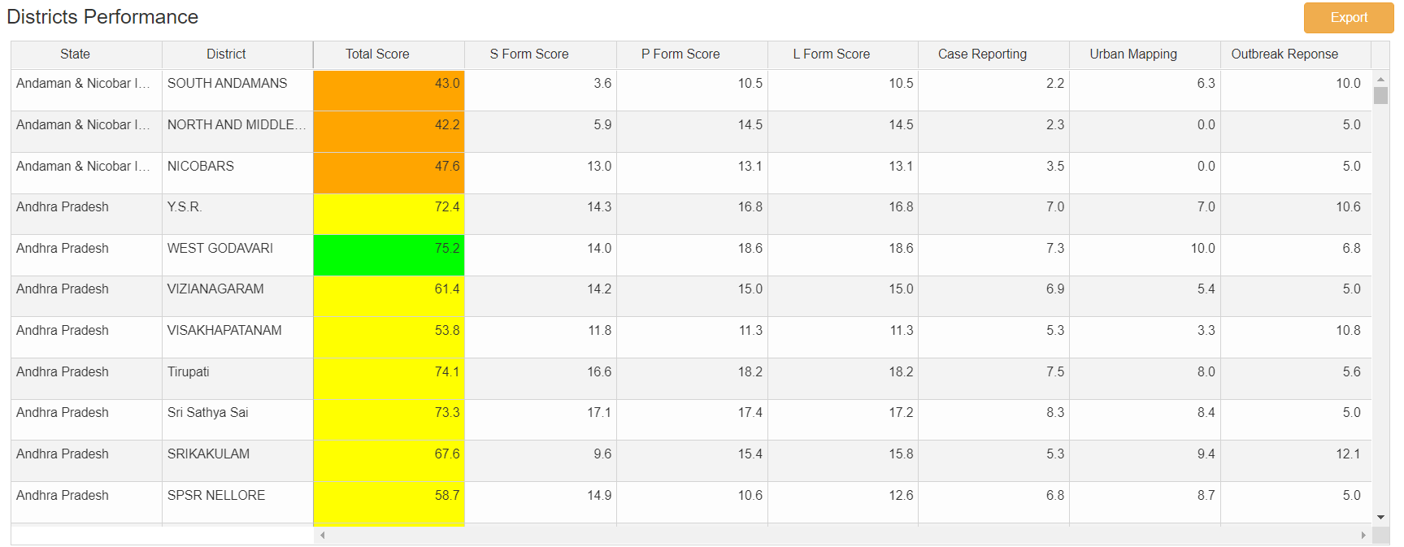
Dashboard – Districts Performance
Table shows district-wise different scores
Can be sorted by clicking on any column heading
Data can be downloaded by clicking on ‘Export’

Slide 9
Dashboard – Score trend
Top & bottom States / Districts as per total score are shown
By selecting a particular state on top filter, ranking of districts for that state can be seen
Data / Image can be exported by clicking on given button

